Slide 1
Break 10:30 am – 10:45 am

Slide 2
New Initiative Presentation
#1

Slide 3
Mental and Somatic Health Services for Veterans
Returning Veterans Project

Slide 4
OUR MISSION and HISTORY
The mission of the Returning Veterans Project is to provide free, confidential mental and physical health services for post-9/11 veterans, service members, and their families in Oregon and Southwest Washington.
Carol Levine, LCSW, founded RVP in 2005 after meeting with an Oregon Army National Guard member who had just returned from Afghanistan. She was committed to doing her part to avoid the mistakes of the past and felt it was our community’s responsibility to care for our veterans and service members returning from post-9/11 war zones, as well as their families.
Carol’s Story:
https://returningveterans.org/news/news/what-brought-us-together/672/
https://returningveterans.org/about/tribute-to-our-founder
Notes:
After meeting with an Oregon Army National Guard Member, just returned from Afghanistan, Carol an LCSW in Portland, decided she didn’t want to see another generation of young people left scarred and unattended to.
Over two days in 2005, she asked several of her counterparts in the industry to help.
25 of them said they’d volunteer their time to see Service Members thus Returning Veterans Project was born.
Carol worked tirelessly until 2021 when she retired, to provide free, confidential mental and physical health services to post-9/11 veterans, service members and their families in Oregon and SW Washington.

Slide 5
OVERVIEW OF PROBLEM
The need is great:
Over half of Post-9/11 Veterans are not enrolled in VA healthcare
Barriers to care are many (e.g., stigma, lack of trust, impacts to career, cost, access)
Oregon and Southwest Washington are without an active-duty military base
Even if a veteran or service member has VA access, their family likely does not
The VA does not provide many services (e.g., family counseling, massage)
Civilian providers may lack understanding of military culture
https://returningveterans.org/about/the-challenge
Notes:
The need is great:
Over half of Post 9/11 Veterans are not enrolled in VA healthcare
Some veterans choose not to enroll in the VA, while others are not eligible or are denied services and the VA doesn’t not serve families.
Barriers to care
Fear, stigma, wait times, costs, confidentiality, eligibility for government programs all present barriers to seeking wellness. Additionally, much of our service area is rural and travel to reach services is increasingly more expensive.
Providers lack understanding/education in military culture
Without training, or lived experience, many Providers are unable to meet the unique needs of Veterans looking for care.
Base-less
- Active Duty Bases/Installations often shed light and funding to the surrounding area on Veteran, Service Member and Military Connected Family needs. Oregon and Southwest WA are without these built in networks and cultures.

Slide 6
OUR SOLUTION
We provide our eligible constituents (clients) with access to free, confidential mental and physical health services through volunteer community providers with no limits on number of services or duration of services provided
How we do it:
Licensed and insured Providers volunteer with RVP (mental health, chiro, acupuncture, massage)
RVP trains Volunteer Providers
RVP lists Providers in an on-line Directory creating a network of confidential services
Providers support at least one client within their scope of practice (clinics & universities serve more)
Clients' self refer and schedule direct with Provider
All services are confidential and pro bono
RVP tracks pro bono services by the hour as donations in kind based
on provider self-reporting
Notes:
We support the healing and health of our veterans and military communities by connecting post-9/11 Veterans, Service Members, and their Families with free, confidential mental and physical health services.
Returning Veterans Project (RVP) Clients use our online directory to access individualized care from a network of highly-qualified volunteer health providers, without any fees or strings attached. Since our founding in 2005, we are removing the barriers to mental and physical health services so that those we serve can have free, confidential access to the care they need.
Providers enter the RVP network with licensure and proof of insurance, RVP maintains these files.
RVP provides orientation, and ongoing CE regarding military culture, veteran issues, and mental health and wellness studies from the VA and others. Education provided is specific to unique issues associated with supporting military clients.
Examples; Strategies to treat and support trauma-related disorders, TBI, PTSD, MST, Suicide prevention, Grief, Women and LGBTQIA+ Veteran issues, the Effects of Deployment on Children and and Ethics.
RVP maintains an on-line directory with the profiles of each Volunteer, accessible to all potential clients.
Providers are not limited to one RVP client, but must maintain one client to remain in the Directory.
We have MOUs with Clinics and Universities that have agreed to see RVP Clients at no cost on their campus. Students are authorized to see RVP clients under supervision.
RVP’s cornerstone is confidentiality. Staff does not interact with the Veteran/Service Member (HIPPA) unless the Client self reports and chooses to share their story. All HIPPA information is between Client and Provider. Volunteers are Volunteering their time and are not authorized to bill insurance or charge RVP Clients.
Volunteers report their hours monthly which we track and report the value of, by modality.

Slide 7
SOLUTION DEVELOPMENT - IMPACT
We have had profound impact:
Since 2005, we’ve served over 3,700 post-9/11 Veterans, Service Members, and Families
In 2022:
2,470 hours of donated health services by volunteers
Post-9/11 Veterans: 269
Active-Duty Service Members: 3
Family Members: 35
Keys to continuing this impact:
Volunteer providers and cultivating our provider network is critical to our success
Training providers in military cultural competency
Refreshing and growing our provider network
Providing on-going relevant Continuing Education and other support to our providers
Outreach to our post 9/11 veterans, service members, and families is also critical and getting harder

Slide 8
VISION and VALUES
RVP Vision:
An improved quality of life for post-9/11 Veterans, Service Members, and their Military Families.
Values:
We believe it is our collective responsibility to offer support, healing, and access to mental and physical health services for our Veterans and military communities. We believe Veterans, Service Members, and their Families have the right to:
Mental and physical health services without stigma or judgment
Confidential services from their Provider of choice
Easy and timely access to the health services they need
Notes:
Mission
To provide free, confidential mental and physical health services for post-9/11 veterans, service members, and their military families in Oregon and Southwest Washington.

Slide 9
HOW YOU CAN GET INVOLVED
Tell your friends, helps us raise awareness, recruit and train Providers
Are you a subject matter expert? Let's educate our Providers!
Providers, Universities and Clinics are encouraged to Join our Mission
Register, get trained and added to our Directory
Become a Charitable Partner, Donor, Contributor
Fund our SW WA efforts
Peruse our webpage, engage us on FB, Instagram and LinkedIn
Encourage usage of RVP services
Notes:
Can you teach?
Do you have physical space to lend, for training?
Are you licensed, do you have a practice, or do you work in a clinic that can join our directory and provide free mental health or somatic care?
Are you in a position to fund our operations?
Are you visible and active on social media? Are you willing to amplify RVP using your platform?
Who do you know that could use our help?

Slide 10
Mental and Somatic Health Services for Veterans
Returning Veterans Project
Notes:
Thank you for your time today.

Slide 11
New Initiative Presentation
#2

Slide 12
Building a Family and Caregiver Academy
Mollie Forrester, MSW, LICSW

Slide 13
BACKGROUND
Benefits of effective family/caregiver engagement
For families/caregivers
Improves understanding of a loved one’s experience
Encourages development of positive coping skills
Enhances social connection and hope
Improves quality of life
When providing effective support, families/caregivers can be an important part of the behavioral health workforce

Slide 14
BACKGROUND
Benefits of effective family/caregiver engagement
For persons with behavioral health conditions
Decreases isolation
Improves supportive connections
Leads to better treatment outcomes and health status
Reduces relapse

Slide 15
BACKGROUND
Barriers to effective family/caregiver engagement
For families/caregivers
Fear, isolation, stigma
Limited access to reliable information, training, and resources
Behavioral health system is complex and hard to navigate
Diverse cultural experiences and perspectives

Slide 16
BACKGROUND
Barriers to effective family/caregiver engagement
Systemic barriers
Unfunded/not covered by insurance
Variable workforce training and experience
Concerns about privacy and consent
Diverse cultural experiences and perspectives

Slide 17
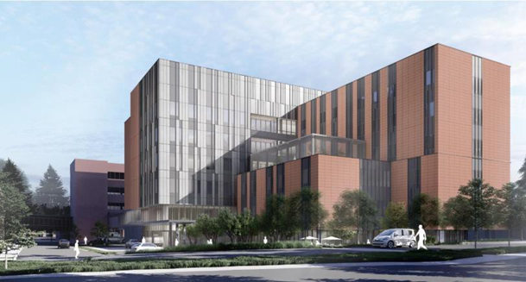
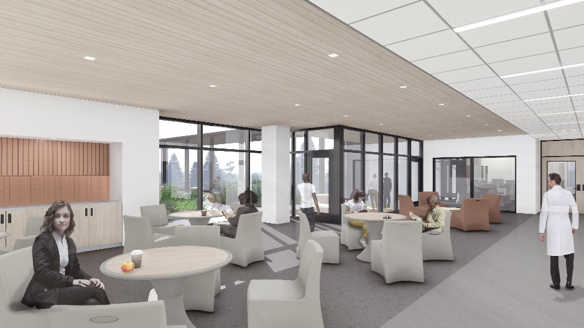
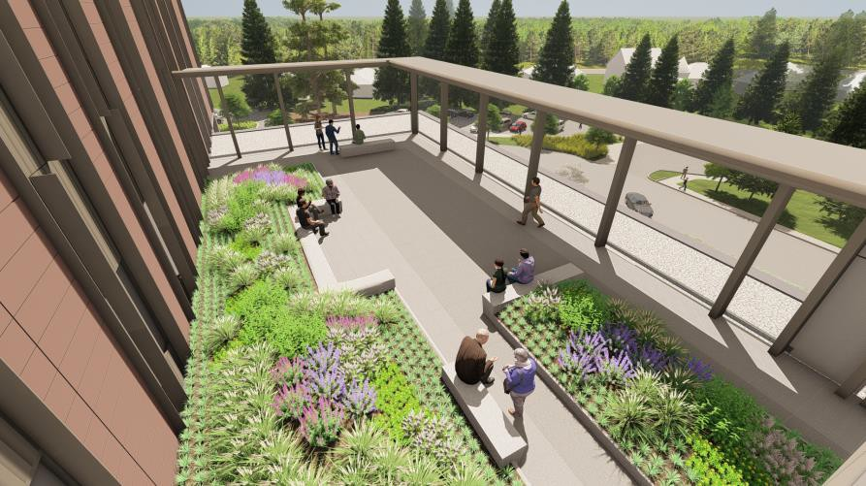
BACKGROUND Center for Behavioral Health & Learning
150-bed teaching hospital at UWMC Northwest
Opening summer 2024
Longer-term inpatient care (adult & geriatric)
Medical / Surgical care
Neuromodulation treatments
Training and workforce development
Family and Caregiver Academy

Slide 18
PROPOSED SOLUTION Family and Caregiver Academy
Provide evidence-based psychoeducation, skill building courses, and curated resources
Serve as an inclusive and collaborative learning and support environment for faculty, staff, trainees, patients, families and caregivers
Support the resilience and long-term health of patients, their families and caregivers
Interdisciplinary team members will learn with and from individuals with lived experience as patient, family or caregiver

Slide 19
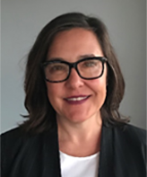
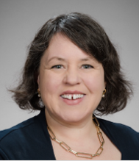
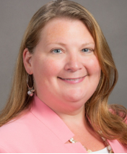
SOLUTION DEVELOPMENT PILOT CORE PROJECT TEAM
Family and Caregiver Academy (FCA) Pilot
Mollie Forrester
Andie Uomoto
Anna
Ratzliff
Alan
Gojdics
Charity Holmes
Strategic partnerships to date: UW SPIRIT Lab: Psychosis REACH & Family Bridger, NAMI, McLean Hospital

Slide 20
SOLUTION DEVELOPMENT Family and Caregiver Academy
What families and caregivers want
Inclusion
Information
Skills
Resources
Support

Slide 21
SOLUTION DEVELOPMENT Family and Caregiver Academy
FCA Asynchronous Training Pilot*
Diagnosis
Specific
Public Information and Patient/Family/Caregiver Council
Transdiagnostic Training and Support
Diagnosis
Specific
* Modules Asynchronous/virtual to start
Orientation to psychiatric hospitalization
Communication Skills course
Diagnosis
Specific
* Website
Curated information and resources

Slide 22
SOLUTION DEVELOPMENT Family and Caregiver Academy
FCA Asynchronous Training Pilot*
Education and Skill Building Modules
Iterative process that includes diverse patient, family and caregiver input and feedback
Pilot Website
Curated educational content and access to training materials
Recruit
Families/caregivers of patients hospitalized at UWMC-NW

Slide 23
SOLUTION DEVELOPMENT Family and Caregiver Academy
FCA Pilot Evaluation
Feasibility - assess practicality of this training approach
Acceptability - assess utility of asynchronous training approach
Family/caregiver engagement - with online materials and completion rates
Post Training Survey and Interviews – family/caregiver experience with and impact of engaging with training
Rehospitalization rates

Slide 24
SOLUTION DEVELOPMENT Family and Caregiver Academy
Secure funding to sustain and grow the FCA model
Build additional collaborations
Expand clinical content
Implement family/caregiver support programming
Integrate with interdisciplinary workforce education and training

Slide 25
VISION Family and Caregiver Academy
We envision a future where we instill hope, eliminate stigma and build compassionate, supportive communities through evidence-based education and training for people living with a behavioral health condition and their families and caregivers.

Slide 26
HOW YOU CAN GET INVOLVED
We would like input on the Family and Caregiver Academy from
people with lived experience as patient, family member/caregiver,
workforce member, and/or advocate
WHO?
From whom should we learn and/or with whom should we collaborate?
WHAT?
What education, training and/or support resources have you used? Liked?
What approaches should we consider? Across diagnoses, inclusive of and accessible to diverse cultures, perspectives, language groups, etc.?
HOW TO CONTRIBUTE?
Volunteer to provide feedback on our curriculum
Share funding opportunities and related advocacy

Slide 27
Building a Family and Caregiver Academy
Mollie Forrester, MSW, LICSW
mgforr@uw.edu

Slide 28
New Initiative Presentation
#3

Slide 29
Preparing Co-Responding Mental Health Professionals to Work with Law Enforcement
MHP Susie Kroll, MA, MHP, LMHC
Hublio Moderator: Andrew Boyer

Slide 30
OVERVIEW OF CHALLENGE
Co-Response is defined as:
Embedding Mental Health Professionals with first responders to address calls for service that involve crisis and often social services and behavioral health intersections.

Slide 31
OVERVIEW OF CHALLENGE
First Responders that can utilize Co-Responding Mental Health Professionals:
Law Enforcement
Fire Services / EMS
We will be focusing on Law Enforcement today

Slide 32
OVERVIEW OF CHALLENGE
Challenges:
Staffing for MHPs
Cultural Integration to First Respondership
safety, industry, justice/social justice, etc
Background Checks & disqualifications to work
Proper crisis training specific to first response
School, Licensure and Clinical Supervision

Slide 33
PROGRESS TO DATE
Staffing for MHPs - legitimatization of industry, UW School of Social Work research, International Co-Responders Outreach Alliance and local groups like Co-Responders Outreach Alliance, growth of programs
Cultural Integration to First Respondership – trainings available at the Criminal Justice Training Commission in Crisis Intervention Training
Background Checks & disqualifications to work – education however…

Slide 34
PROGRESS TO DATE
Proper crisis training specific to first response- Crisis Intervention Training (CIT), local and private provider trainings, largely self-or “on the job” training
Licensure and Clinical Supervision – current Dept of Health requirements however…

Slide 35
MOVING FORWARD
Promotion of the industry starting in high school
Advanced Crisis Training for 1st Responder fieldwork
CoR Clinical Credential
CoR M-Master’s Level Clinician with CoR Training for role
CoR B-Bachelor’s Level Case Mgr with CoR Training for role
CoR P-Peer Support Specialist with CoR Training for role
CoR CS-Master’s Level Dept of Health Credentialed Clinical Supervisor with CoR Training and Specialized Supervision experience

Slide 36
TAKING ACTION
We have engaged Lobbyist Brad Banks and
Co-Responders Outreach Alliance for Legislative Support for Credentialing
We Need:
more legislative support
earlier engagement for students to do the work
student loan considerations
Department of Health engagement

Slide 37
VISION
We would be building our future work force earlier so address backgrounds and disqualifications
We would have appropriate trainings for this specialized work and cultural integration
We would have more MHPs to fill the growing number of vacancies in Co-Response to serve our community members in crisis

Slide 38
HOW YOU CAN GET INVOLVED
I have legislative influence and can support Co-Response legislation, credentialing, and/or student loan
I have influence or work with the Dept of Health and can assist in the development of a CoR Credential in WA State
I am a licensed Mental Health Professional and I would like to explore this type of employment

Slide 39
HOW YOU CAN GET INVOLVED
Contact Information:
MHP Susie Kroll, MA, MHP, LMHC
206-305-9509
Susie.Kroll@kingcounty.gov

Slide 40
Lunch & Exhibit Hall 12:15 pm – 1:15 pm

