Slide 1
Past Initiative Updates

Slide 2
Expanding Washington's Behavioral Health Workforce with Bachelor-level Behavioral Health Support Specialists
Anna Ratzliff

Slide 3
OVERVIEW OF ORIGINAL PROBLEM
At any time in the last 4 weeks, did you need counseling or therapy from a mental health professional, but did not get it for any reason?
Gap
Many people need access to therapy
Currently takes many years to train new providers
Bachelor-level providers can rapidly expand the workforce
52 % of Behavioral Health Providers stated this type of credential is mostly needed or essential

Slide 4
WORKFORCE INITIATIVE VISION
Patient improves and returns to care as needed
Behavioral Health
Patient
BHSS
Patient
OR
Patient needs more intensive treatment and works directly with behavioral health provider with full scope of practice
Patient presents with depression
Medical
Patient
Provider with diagnostic scope of practice diagnoses depression and recommends low intensity CBT
Patient receives low-intensity CBT and regular measurement of symptoms
BHSS coordinates care with provider
Patient
Behavioral Health

Slide 5
PROPOSED SOLUTIONS
Curriculum
Educational Partners: Continue to develop new partners
Practice
Job Description: Develop job role details with partners
Policy
Licensure Requirements: Complete development of licensure; Develop legislation as needed
Payment and Billing: Explore new sources of revenue; Advocate for reimbursement in WA State
Clinics/Employers: Develop role and hiring support for early adopter clinics; Consider pediatrics and perinatal
Didactic curriculum: Provide content for courses to any educational partner
Practicum Experiences: Partner with new sites; Provide implementation support
Skills Training: Continue to develop the ITS; Develop modified Anxiety Treatment Protocol

Slide 6
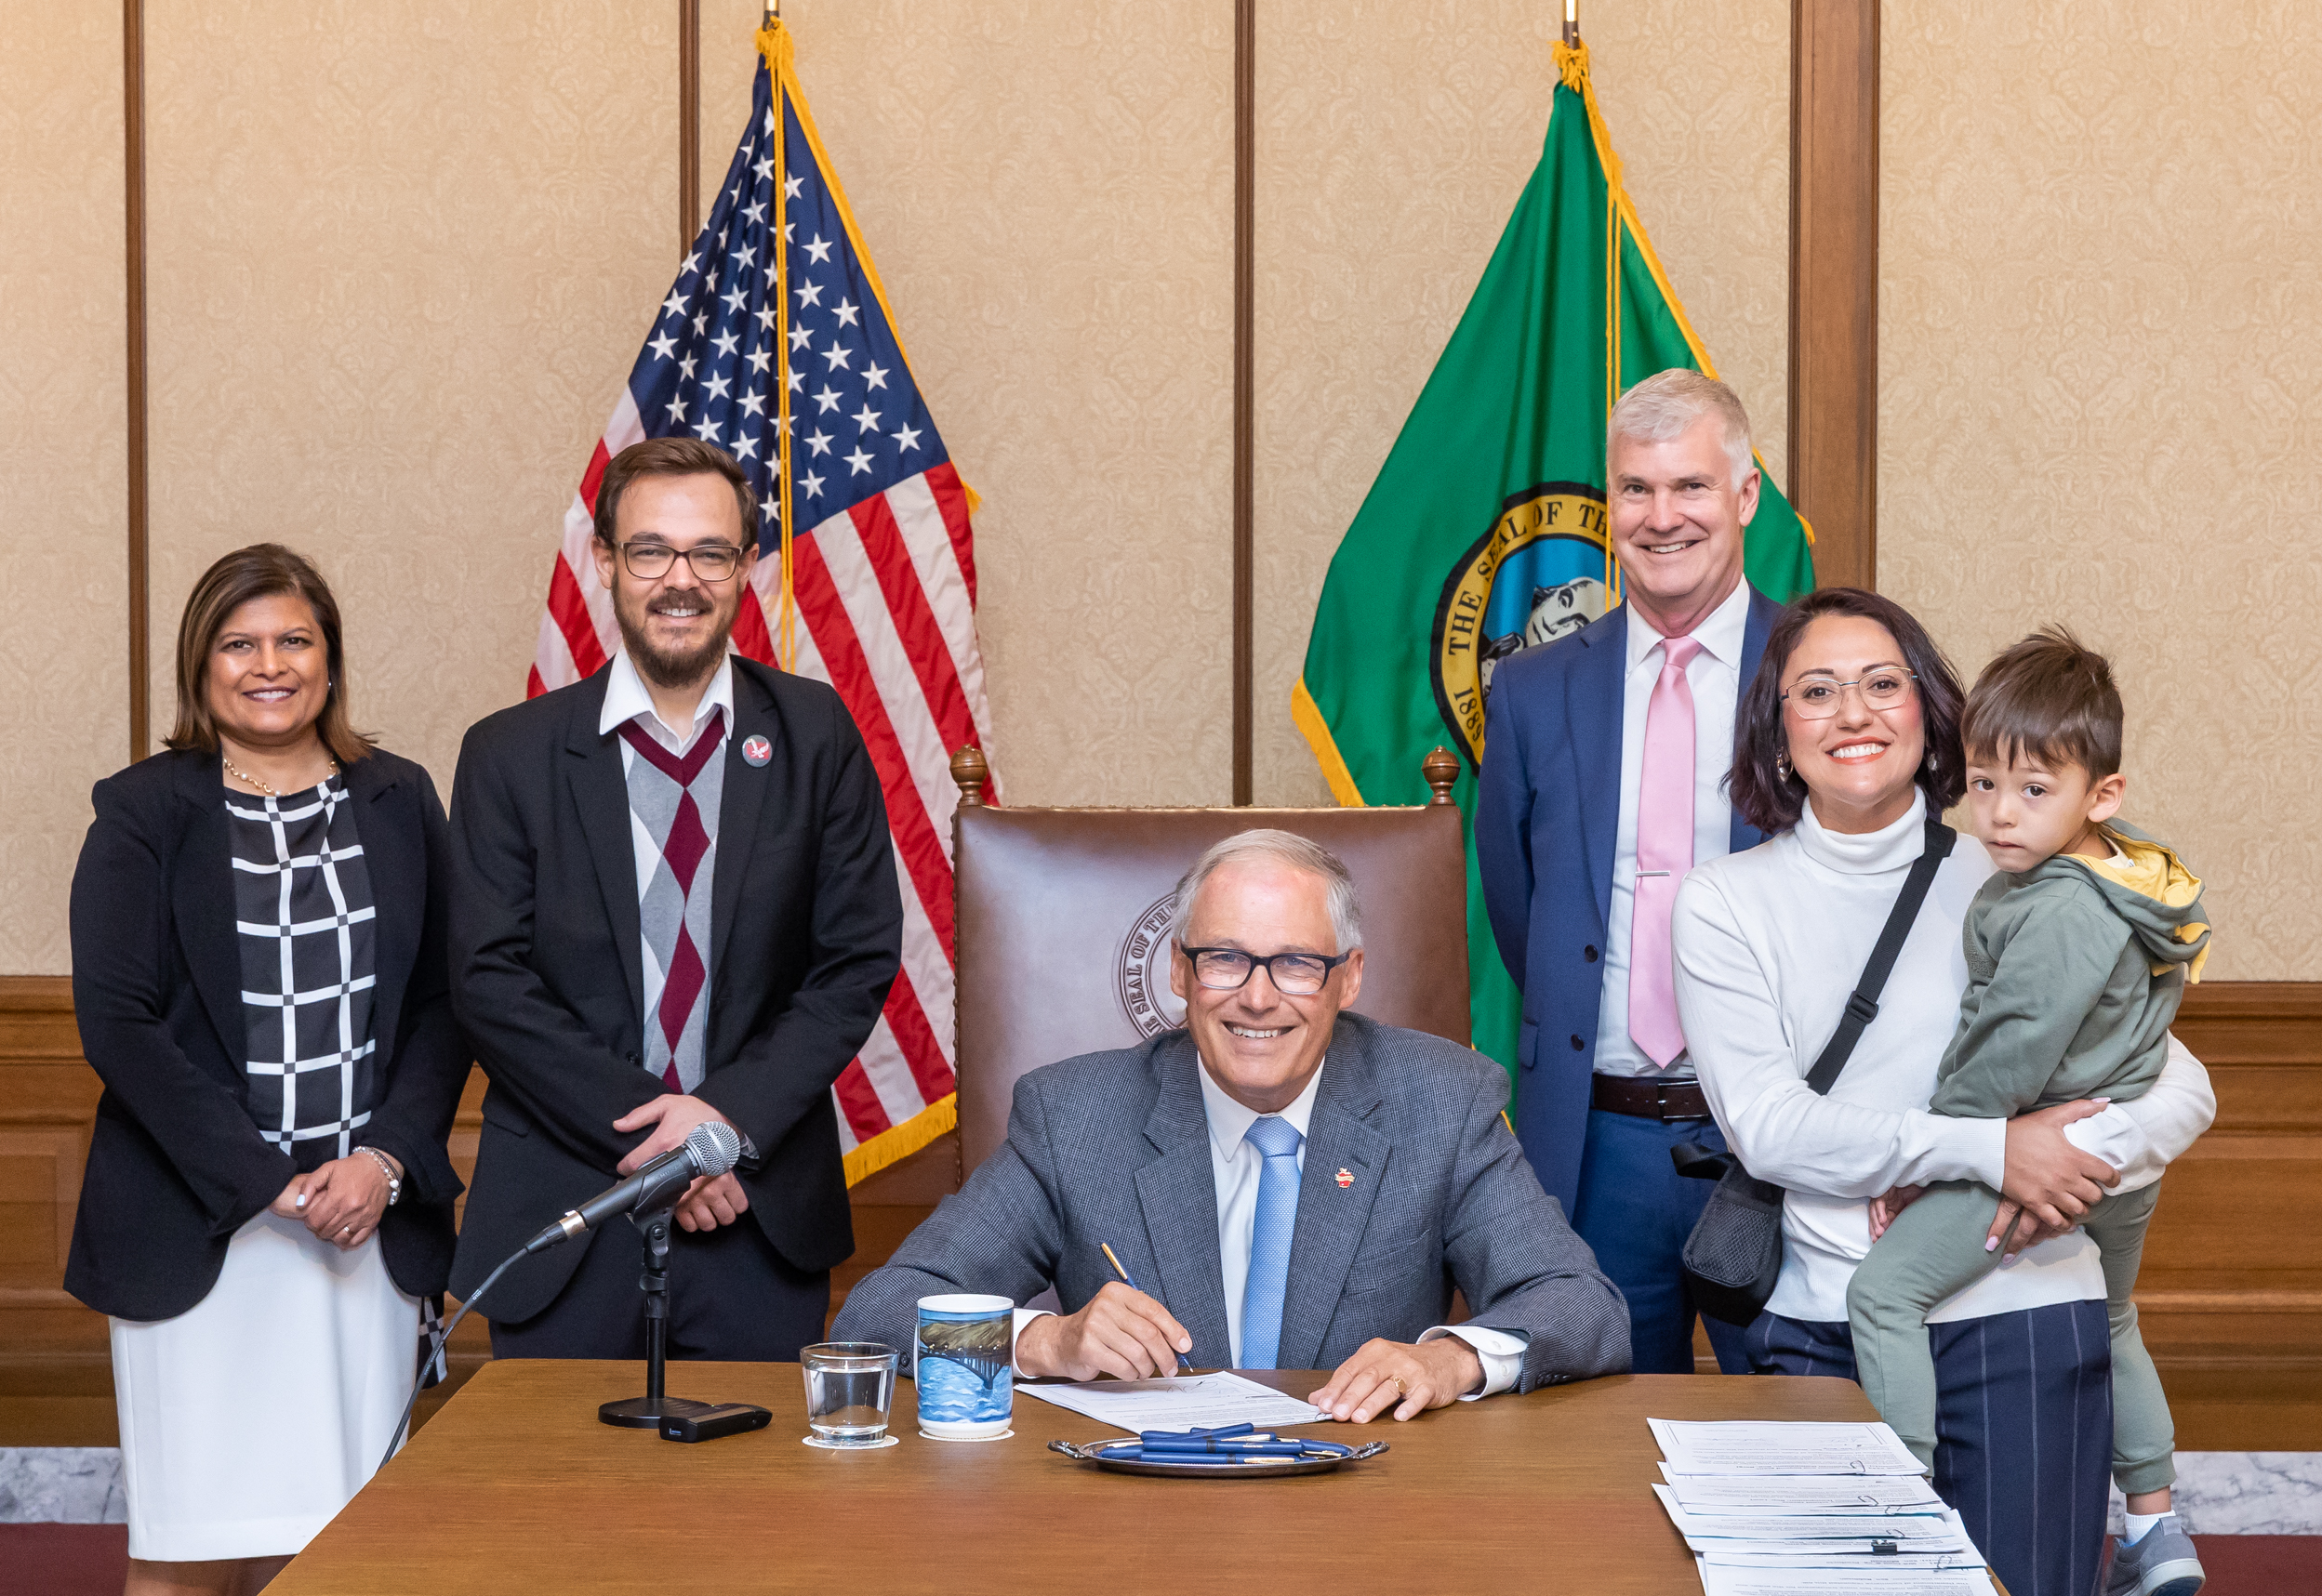
SOLUTION DEVELOPMENT
SSB 5189
Established BHSS as a new WA provider type
UW Psychiatry & Behavioral Sciences
Leading BHSS Clinical Training Program development
Higher Education Partners
Deliver BHSS Curriculum
Behavioral Health Community Partners
Host BHSS Practicum/Internships
Department of Health and Health Care Authority
Oversee BHSS credential & modify State plan to include BHSS

Slide 7
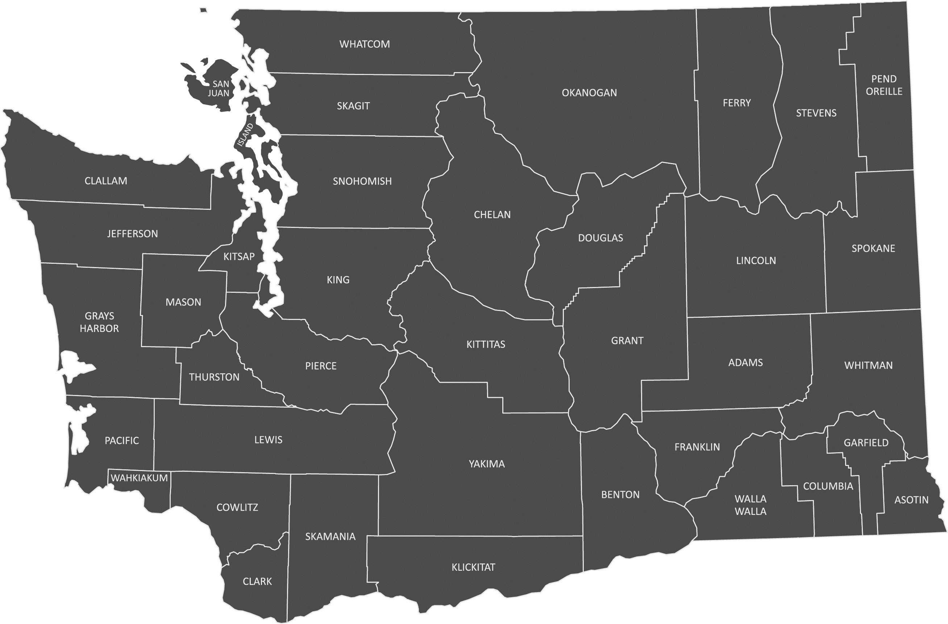
SOLUTION DEVELOPMENT
LWTech
Eastern Washington University
Defined Meta Competencies
Health Equity
Helping Relationships
Cultural Responsiveness
Team-Based Care and Collaboration
Screening and Assessment
Care Planning and Care Coordination
Intervention
Law, Ethics & Professional Practice
UW Tacoma
Evergreen College
Spokane Falls Community College
Centralia College

Slide 8
VISION
Goal:
50 providers trained and 40 providers in practice by July 2026
Contact: BHSSWA@uw.edu
Team Contacts: Bill O'Connell, Savanah Tidwell, Anna Ratzliff

Slide 9
BH 360
Stefanie Robinson

Slide 10
BH360
On a mission to bring greater equity and increased access to youth behavioral health supports

Slide 11
YOUTH BEHAVIORAL HEALTH CRISIS
1
Impacts of the pandemic resulted in increased depression, anxiety, and suicidal ideation for youth
2
Historically marginalized and economically impoverished
are furthest from help
3
Limited access to providers,
yet increased demand and long wait times
4
Finding culturally and clinically relevant resources is
overwhelming and at times of crisis feels paralyzing

Slide 12
What would you do if your child needed behavioral health support?

Slide 13
THE BH360 PATHWAY
CAREGIVER TOOLKITS
BH360 is an aspect of a behavioral health system redesign underway via a strategic planning process in Washington State.
The platform provides an opportunity to engage parents as partners in their children's care in ways we've never seen before.
CAREGIVER
COMMUNITY FORUMS
AI GUIDANCE + CHAT INTEGRATION
ONGOING SUPPORT
DATA ANALYSIS FOR STATE VISIBILITY
ENHANCED PERSONALIZATION
AWARENESS
PROVIDER FIT QUESTIONS
FILTERABLE PRIVATE / PUBLIC PROVIDER LISTSINGS
INTERVENTION
CULTURALLY-FIT RESOURCES – CAREGIVER + YOUTH
SCHOOL-BASED RESOURCES
SCREENING TOOLS
ADVOCACY GUIDANCE + UNDERSTANDING LEGAL RIGHTS
LOCAL HEALTH RESOURCES
PSYCHO-EDUCATIONAL CONTENT
DOCUMENT STORAGE + SHARING
CULTURALLY RESPONSIVE LANGUAGE
COMMUNITY ENGAGEMENT

Slide 14
Parent Psycho-ed Resources
Provide educational, culturally tailored resources for parents
Child Psycho-ed Resources
BH360:
Connecting the Pieces
Provide educational, culturally specific resources for youth
School Resources
Provide families with resources that help them advocate and seek resources through their schools.
Community Resources-Youth
Help families connect their child to culturally responsive resources in their community (e.g., peer groups, youth forums, etc.)
Community Resources- Parent
I
Help caregivers connect to personalized and culturally relevant / responsive resources in their community (e.g., parent support groups, educational classes/books, etc.)
Specialized Behavioral Health Providers
Help families connect to curated providers (tailored by specific needs [insurance, problem area, cultural identity, etc.])

Slide 15
PARTNERSHIPS CONNECTIONS
Our goal is to map the resources for Yakima across these domains
ENABLING RELATIONSHIPS STATE-WIDE TO BRIDGE EXISTING GAPS FOR YOUTH BEHAVIORAL HEALTH
PROVIDER RESOURCES
School-based supports and intersection points
Large multi-state providers identifying BH needs
YOUTH RESOURCES
BH360
Non-profits supporting WA state families in need
CAREGIVER RESOURCES
Programs supporting families in under resourced areas
SCHOOL RESOURCES
STATE-WIDE RESOURCES
COMMUNITY SPECIFIC RESOURCES

Slide 16
BUILDING A BRIDGE FOR LONG TERM SUPPORT
BH360: LONG TERM VISION
BH360 IS HERE
PROTOTYPE
PILOT
LAUNCH
360: FUTURE
The proof-of-concept site has been built and garnered great enthusiasm and interest from families as a must-have tool for families navigating behavioral health needs for their child.
**A mix of public and private funding will bring the tool to the pilot stage at which time we aim to engage in diverse communities across the state to test the efficacy of the site as an impactful resource.
The pilot stage will measure family engagement and a demonstrated ROI for Washington state with BH360 as a necessary resource
Demonstrated ROI for Washington State will reinforce the need for the 360 platform to be a state funded program that helps families across Washington in need
We have begun discussions with WA state legislators and will continue to do so as we move the product through the development pipeline
The BH360 prototype and work to date has been completed via a grant of $100k provided via a generous donor and ongoing investment of $300k+ from RPrime Foundation
**Challenges in securing private dollars to support the development of BH360 during uncertain financial times and state funding can not be accessed until 2024-2025, resulting in slow progress of the platform

Slide 17
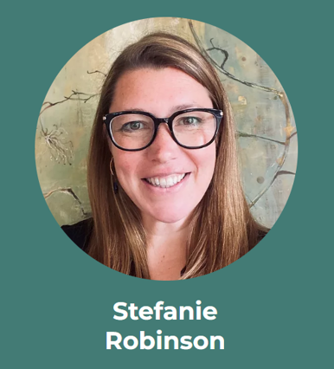
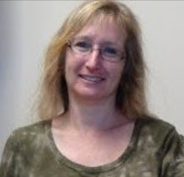
THE BH360 TEAM
Jackie St Louis, DPA, MSC, LMHC, MHP
Licensed therapist
Equity and social justice leader
Taylor Odegard
Peggy Dolane
Janice Schutz
Jerri Clark
Jean Ross
CEO, NavigatorCRE
Technical Lead
Parent Advocate
Policy Liasion
CEO, WSCC
Government Coordination
Founder, MOMI
Content Editor
Founder, MOMI
Content Editor

Slide 18
APPENDIX

Slide 19
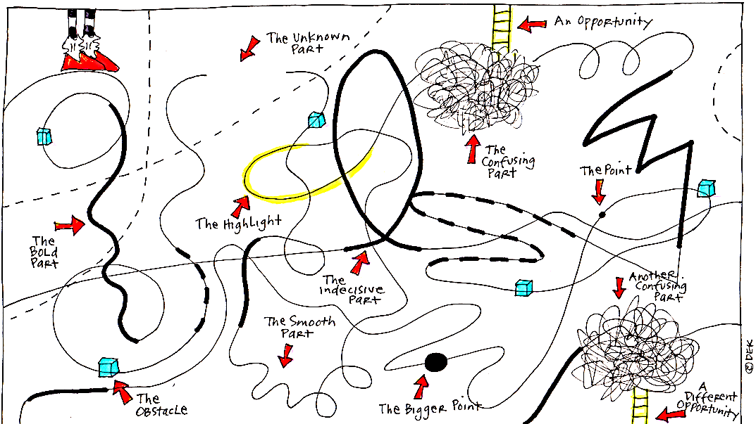
“[There are] Gaps in services, but there are also enormous gaps in education and stigma reduction and the normalization of accessing behavioral health supports at large“ – Parent with lived experience
If one googles “Behavioral health resources Washington”, 2.38 billion results appear
In Washington, our systems are disconnected and disparate, meaning navigating the systems one needs “can mean sorting through a tangled web of confusing diagnoses, frustrating conversations with insurers, and varying levels of care at private and public health care agencies”⁵
NAVIGATING YOUTH BEHAVIORAL HEALTH NEEDS
Living in poor or low- income household has been linked to increased risk for mental health problems in children³
41% of counties in Washington state do not have one single licensed professional for behavioral health services¹
"The system is not only about the treatment and services for children but all the supports needed for families” – Parent with lived experience
In Washington it is estimated that 15.3 – 17.7% of youth ages 0 – 17 are in need of behavioral health services and roughly only half of them receive the care they need²

Slide 20
References
Through public and private investment, we can transform behavioral health care in Washington Through public and private investment, we can transform behavioral health care in Washington | Office of the President
Behavioral Health Services in Washington Behavioral health services in Washington | CDC
Improving Mental Health Access for Low-Income Children and Families in the Primary Care Setting Improving Mental Health Access for Low-Income Children and Families in the Primary Care Setting - PubMed (nih.gov)
Mapping mental health care in Washington: A look at how the system works, and its gaps Mapping mental health care in Washington: A look at how the system works, and its gaps | The Seattle Times
How to fix Washington’s mental and behavioral health care system? 4 experts weigh in How to fix Washington’s mental and behavioral health care system? 4 experts weigh in | The Seattle Times
Kids are waiting months for psychiatric beds. Why it’s such a struggle to expand care in WA Kids are waiting months for psychiatric beds. Why it’s such a struggle to expand care in WA | The Seattle Times
US National and State-Level Prevalence of Mental Health Disorders and Disparities of Mental Health Care Use in Children US National and State-Level Prevalence of Mental Health Disorders and Disparities of Mental Health Care Use in Children | Pediatrics | JAMA Pediatrics | JAMA Network
Consensus approach & recommendations for the creation of a comprehensive crisis response system 988-Crisis-Response-Report-November-FINAL.pdf (wellbeingtrust.org)

Slide 21
Mainstreaming the Mental Health Advance Directive
in Washington State
Originally presented by:
Todd Crooks, Chad’s Legacy Project
Senator Karen Keiser, Washington State Senate
Laurie Hallmark, Texas Rio Grande Legal Aid
Gail Kogle, Spokane Region Ombuds
Ryan Robertson, Washington State Hospital Association

Slide 22
OVERVIEW OF ORIGINAL PROBLEM
The Overall Principal of a Mental Health Advance Directive
A tool by with individuals are enabled to introduce self-determination in the midst of a mental health crisis
An aid to first responders and providers in determining already existing and most successful approaches to first contact and care
The reduction of both compulsory admissions and trial and error treatment
(JAMA Psychiatry. 2022;79(8):752-759. doi:10.1001/jamapsychiatry.2022.1627)

Slide 23
OVERVIEW OF ORIGINAL PROBLEM
The Washington State Mental Health
Advance Directive (MHAD) is underutilized
Providers are hesitant to follow the MHAD due to concerns about legality,
document access, and potential conflict between what a consumer wrote and
signed and what they are articulating during a decompensating episode.
There is no existing reliable method for document creation, storage, and sharing.
As a result, many providers, potential consumers, families, and other stakeholders
don’t know about the MHAD or how to use it.
Four Key areas identified as improvement opportunities

Slide 24
INITIATIVE VISION
To build a comprehensive system in which the Mental Health Advance Directive is a widely used and accepted tool to foster self-determination of care and to shorten the path to positive outcomes and recovery.

Slide 25
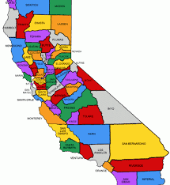
SOLUTION DEVELOPMENT
2022:
Collaboration with the State of California
Their effort to build pilots for a Psychiatric Advance Directive in seven counties -
Extensive work around repositories and best practices
Building a legislative ask for the 2023 Washington State legislative session
SB 5660
The creation of an HCA legislative workgroup convene a statewide Mental Health Advance Directive Document Storage Task Force and facilitate a report of findings and recommendations.
To convene a statewide Mental Health Advance Directive Document Creation and Training Task Force and facilitate a report of findings and recommendations.

Slide 26
SOLUTION DEVELOPMENT
2023 Legislative Result:
SB 5660 did not make it out of Ways and Means
Our workgroup asked to continue work in 2023 and prepare for larger legislative ask in 2024

Slide 27
SOLUTION DEVELOPMENT
2023 Workgroup Activities
Environmental scan and stakeholder engagement
Report and research review to understand developments locally, nationally and around the world that advance the use of Mental Health Advance Directives
Key stakeholder interviews and scan of related initiatives to identify the most impactful opportunities for collaboration and alignment and to avoid duplication of efforts
Engagement with key partners invested in advancing the use of Mental Health Advance Directives

Slide 28
SOLUTION DEVELOPMENT
2023 Workgroup Activities
Mental Health Advance Directive Community Survey
Survey was focused on understanding best practices and barriers to meaningfully using Mental Health Advance Directives in care around WA State
Distributed to care providers around the state
Received 89 responses to the survey
Received valuable information on the opportunities and barriers to Mental Health Advance Directive use that will inform ongoing work

Slide 29
SOLUTION DEVELOPMENT
2023 Workgroup Activities
Repository research
Identification of most likely technological opportunities
recommendations on capabilities and access
-Epic Electronic Medical Records development
-Leveraging 988

Slide 30
THE SOLUTION
The 2024 Legislative Ask
Forming an ask of what could be possible.
Discussions underway to determine feasibility and likelihood of legislative success to create a formal HCA Workgroup to;
Adopt a slate of best practices for the introduction, counseling and completion of the document.
Collate existing training material and utilize material development experts to adapt materials to specific parts of the stakeholder communities involved in the MHAD process
Create a repository within the Washington State HCA to house the library of training toolkits and build an awareness campaign so these toolkits are utilized.
Utilize the technologies of the 988 system to create a document
storage repository bridged to Electronic Medical Records

Slide 31
THE WORKGROUP
Expected to grow following the 2024 legislative session
New stakeholders with direct input for next phase
First Responder Representation
Front Line Certified Peer Counselors
Emergency Department Providers
Training Program Developers
If you’d like to get involved, contact Todd Crooks, toddcrooks@comcast.net
(and via today’s Hubilo app)

Slide 32
Mainstreaming the Mental Health Advance Directive
in Washington State
Originally presented by:
Todd Crooks, Chad’s Legacy Project
Senator Karen Keiser, Washington State Senate
Laurie Hallmark, Texas Rio Grande Legal Aid
Gail Kogle, Spokane Region Ombuds
Ryan Robertson, Washington State Hospital Association

Slide 33
Break 10:30 am – 10:45 am

